Slide 1

HR Analytics
Group 6

Slide 2
Team Member
Rahul Dnyaneshwar Tarale
Ponnuru Gnana Sree
Vinit Shah
Sama Deepika
Ananya Soni
Omkar Kumbhar
Anjana.M

Slide 3
Introduction
In today's rapidly evolving business world, talent management has become a critical strategic imperative. As we kick off our Employee Retention Analysis project, it's essential to acknowledge the significant shifts in how organizations approach attracting, retaining, and nurturing their workforce. The traditional model of employment, characterized by long-term loyalty to a single company, has given way to a more dynamic and competitive landscape

Slide 4
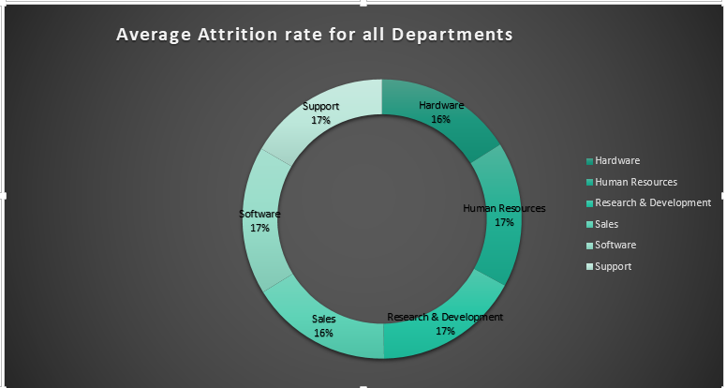
Average Attrition Rate of All Department
The average attrition rate is about 50%, meaning nearly half of employees leave or change roles each year.
Attrition varies slightly across departments, showing different levels of stability.
The Hardware department has a lower attrition rate (~49%), indicating better retention.
Research & Development and Software departments have slightly higher attrition (~51%), suggesting possible retention concerns.

Slide 5
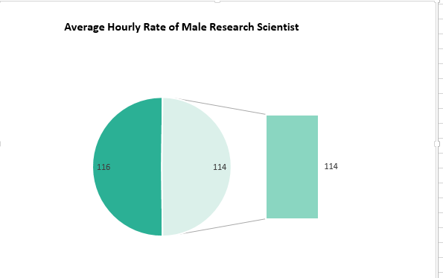
Average Hourly Rate of Male Research Scientist
The average hourly pay for research scientists shows a very small difference by gender.
Male scientists earn about $115.93 per hour, while female scientists earn about $114.45 per hour.
This indicates a minimal gender pay gap in research science roles.

Slide 6
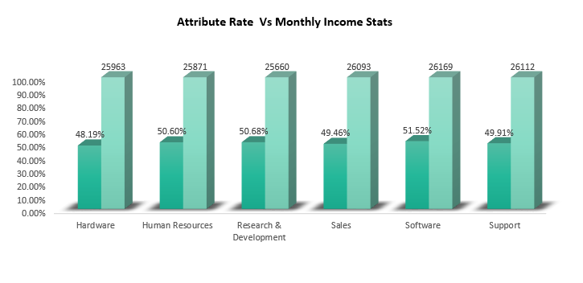
Attribute Rate V/S Monthly Income
Attrition rates vary slightly across departments.
The Hardware department has the lowest attrition (~49%), while Research & Development and Software have the highest (~51%).
This indicates the need to identify and address department-specific factors affecting employee retention.
The average monthly income across departments is relatively similar, ranging from ₹25,796 to ₹26,118.

Slide 7
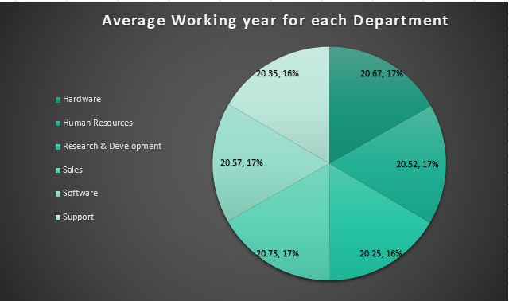
Average Working Year of All Department
The average working years across departments are very stable, around 20 years.
Hardware (20.48 yrs), Human Resources (20.45 yrs), and Support (20.48 yrs) show similar tenure levels
This consistency indicates a stable workforce that helps retain organizational knowledge and expertise.
Sales (20.62 yrs) and Software (20.65 yrs) have slightly higher average tenure.

Slide 8
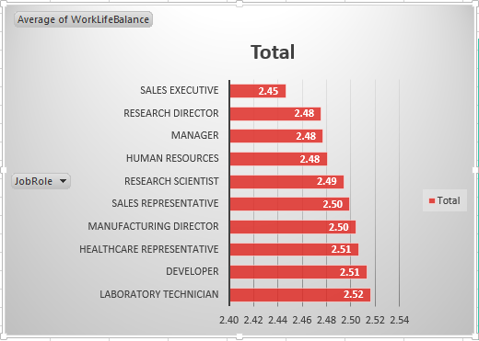
Work Life Balance Matrix
Job roles with better work-life balance include Healthcare Representatives and Human Resources professionals, with average scores above 1,230.
Roles such as Manufacturing Directors and Sales Executives show comparatively poorer work-life balance, with scores below 1,250.
Work-life balance can differ widely within the same job role.
For example, Research Scientists have an average score around 1,256, but individual scores range from above 1,280 (excellent balance) to below 1,240 (poor balance).
This variation highlights that personal factors, team environment, workload, and company policies strongly influence work-life balance, even within the same job category.

Slide 9
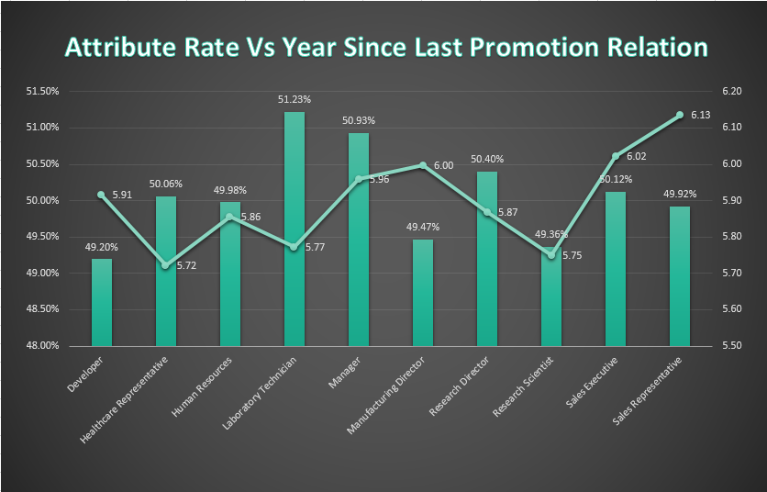
Attribute Rate V/S Last Year Promotion
0–5 years since last promotion: Research & Development has the highest attrition, while Hardware has the lowest.
6–10 years since last promotion: Human Resources shows the highest attrition, and Software has the lowest.
11–15 years since last promotion: Support has the highest attrition, while Sales has the lowest.
16–20 years since last promotion: Software shows the highest attrition, and Hardware has the lowest.
21–25 years since last promotion: Software has the highest attrition, while Support has the lowest.
26–30 years since last promotion: Support shows the highest attrition, and Human Resources has the lowest.
Above 30 years since last promotion: Software has the highest attrition, while Human Resources has the lowest.

Slide 10
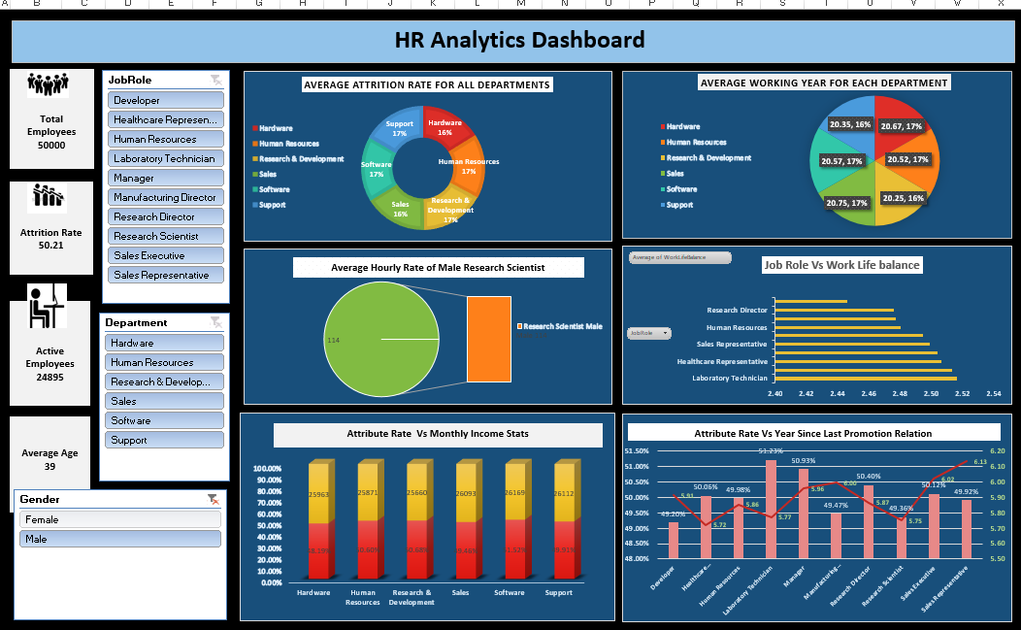

Slide 11
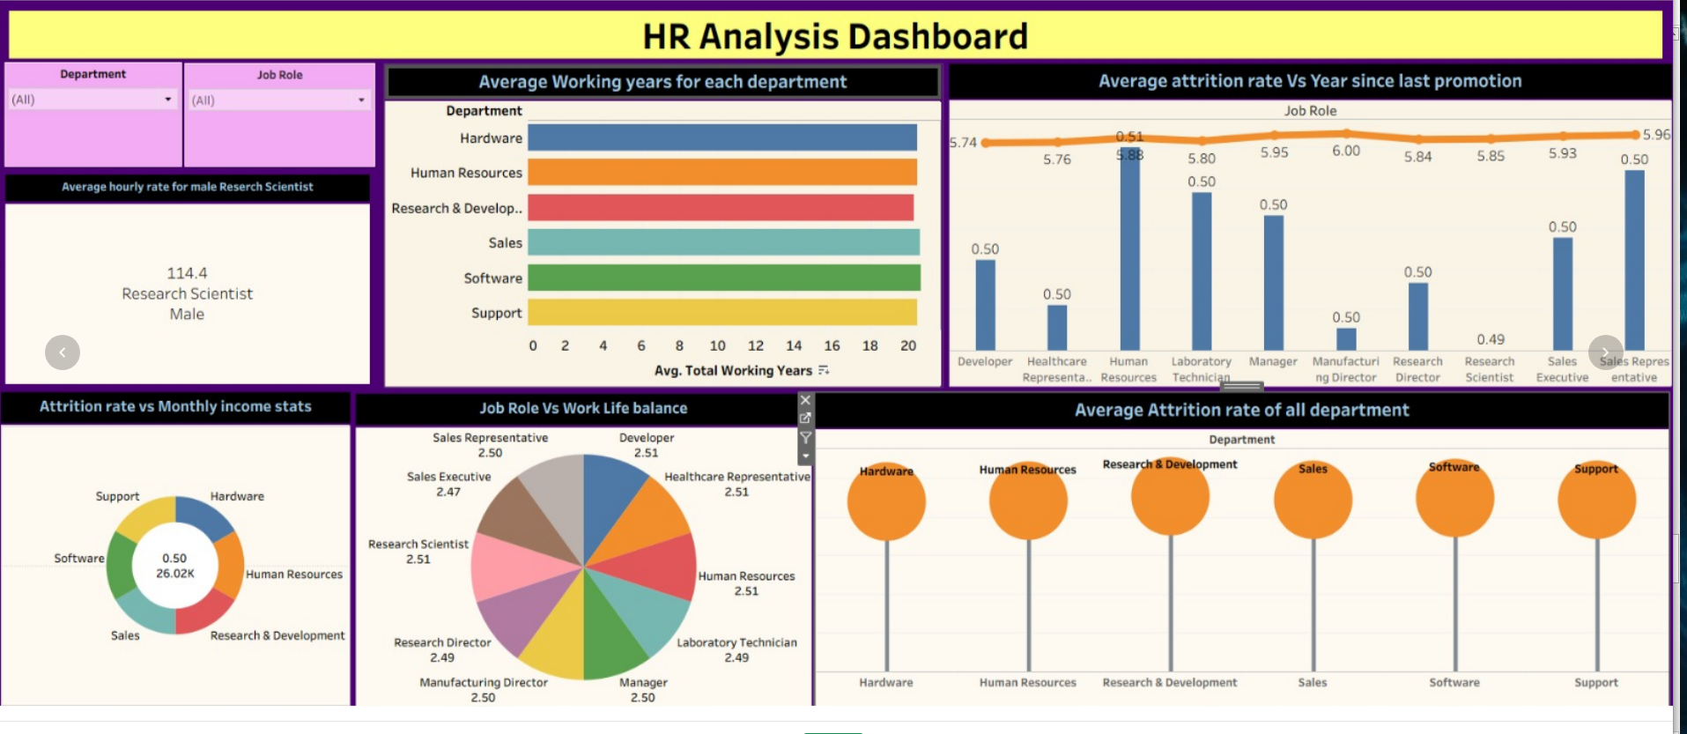

Slide 12
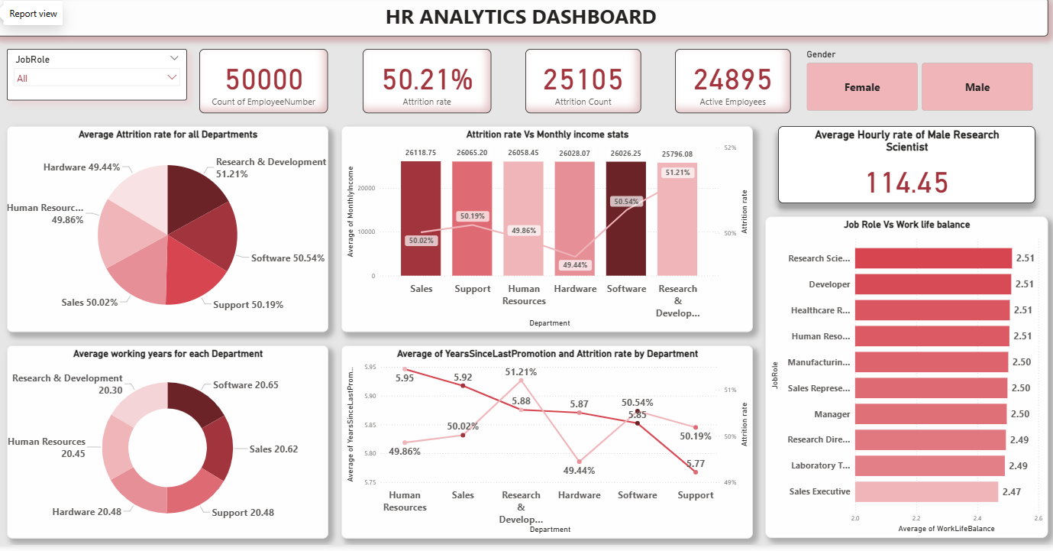

Slide 13

Conclusion
The HR Analytics reveals a critically high attrition rate of 50.21%, indicating serious employee retention challenges. Attrition appears consistent across departments, suggesting systemic organizational issues rather than department-specific problems. Work-life balance varies by job role, with operational roles showing slightly lower satisfaction. Salary differences do not strongly explain attrition, indicating that compensation alone is not the primary cause. A key factor appears to be delayed promotions and limited career growth opportunities. With only 24,895 active employees out of 50,000, turnover is substantial. Overall, the data highlights the need for improved career progression, engagement strategies, and organizational culture enhancements.

Slide 14

Thank You for you Time

